Slide 1
Introduction to Computing
for the Social Sciences
Session 9 - Formal Languages and Automata
David Garcia
Winter Semester 2024-25
18.12.2024

Slide 2
Course Outline
Session 1: Introduction
Session 2: Information Coding
Session 3: Data Structures
Session 4: Programming
Session 5: Algorithms
Session 6: Recursion
Session 7: Sorting Algorithms
Session 8: Time Complexity
Session 9: Formal Languages and Automata
Session 10: Turing Machines and Complexity Classes
Session 11: Databases
Session 12: Parallel Programming
On Friday 17.01, 10:00-13:15, room D406
Session 13: Social Science Applications
Session 14: Exam Review
Reminder: Slide comments and
support after pen-and-paper exercises

Slide 3
Outline
Questions of Theoretical Computer Science
Finite-state Automata
Formal Languages and Grammars
The Chomsky Hierarchy
Push-down Automata

Slide 4
Motivation
Why study theory of computation?
As compared to algorithms, data structures etc, theory of computation is less oriented to practical applications
BUT computer science is more than just writing code
At its core, computer science is about problem solving
Theory of computation lets us answer:
What are fundamental capabilities and limitations of computers?

Slide 5
Motivation
Theoretical computer science questions:
what can we compute?
what are the principles of computing machines?
how a computing machine has to be structured to perform (any) computing task?
Topics of theoretical computer science:
formal definitions of languages and their classification
ways of formalizing computation as a an abstract process of transition between states of a computer program independent of its implementation
proofs of computability based on these theoretical constructs

Slide 6
Motivation
Fundamental understanding of the theory of computing is important:
How do we model computing? How do we abstract this process?
modeling input: breaks down to accepting a finite sequence of bits
modeling output: from a finite sequence of bits we can, in principle, constitute any output (numbers, graphics, sound etc.)
modeling processing:
in principle, bit-by-bit operations but need to have memory to keep track of intermediate steps
“power” of computing models ultimately changes with their ability to memorize intermediate steps
and we need rules that define how we transition from one operation to the next e.g.: calculating machines are based on arithmetic operations
more generally, computing machine must have rules to transition between a finite number of internal states

Slide 7
Finite-state Automata
Questions of Theoretical Computer Science
Finite-state Automata
Formal Languages and Grammars
Push-down Automata
The Chomsky Hierarchy

Slide 8
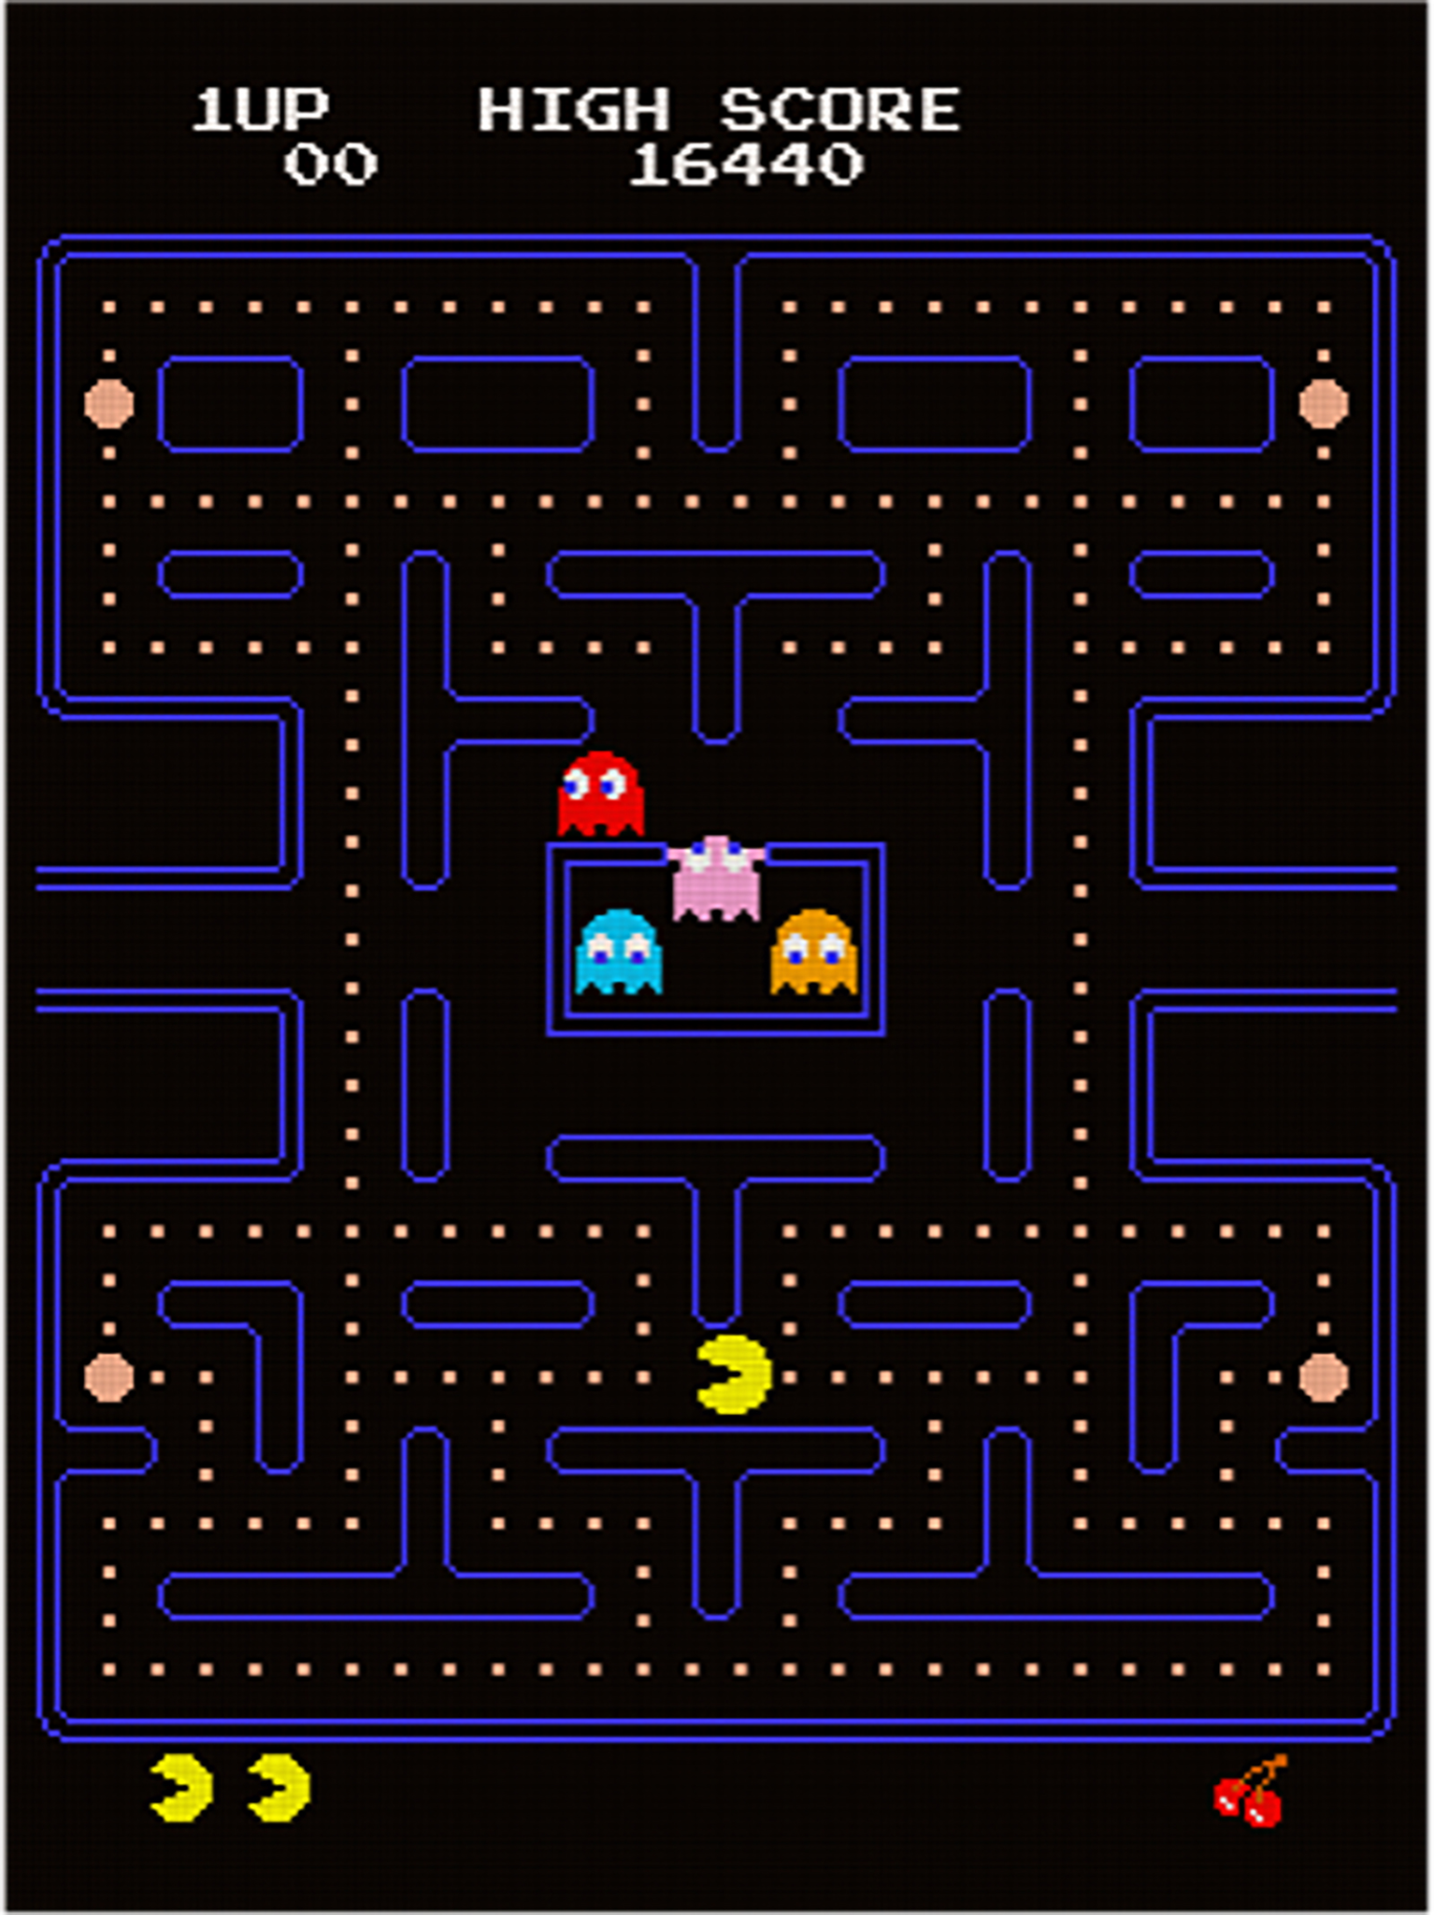
Pac-Man ghosts as automata
Pac-man ghosts have actions depending on their state:
Wander around the maze
Chase pac-man
Flee from pac-man
Go to base and resurrect
Their actions depend on the input produced by pac-man and the game, for example:
pac-man gets close to a ghost
pac-man goes far from a ghost
pac-man eats a special pellet
pac-man touches ghost (losing)
pac-man eats ghost (with special pellet)
special pellet expires
pac-man eats all pellets
Ghosts are automata: they have states and transitions between states that depend on the input

Slide 9
Finite-state automaton
Definition: deterministic finite state automaton (DFA)
A deterministic finite state automaton is defined by a 5-tuple M = (Q, Σ, δ, q₀, X) consisting of :
Q, a finite set of states
Σ, a finite set of input symbols called the alphabet, Q ∩ Σ = ∅
δ: Q × Σ → Q, a transition function
q₀ ∈ Q, an initial or start state
X ⊆ Q, a set of accept states

Slide 10
Finite-state automaton
Functioning of automaton:
is initially in start state q₀
input word is read character-by-character (or command-by-command)
automaton transitions from state to state according to each character input
if automaton ends up in an accept state, word (or command sequence) is part of language
if not, it is not part of the language
Convention: if a transition is not defined for a state and character input, then the automaton goes to a non-terminal reject state

Slide 11
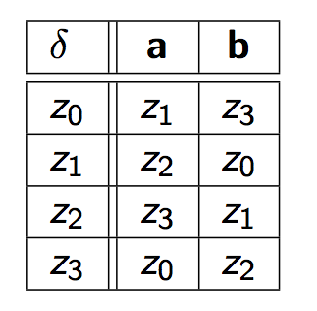
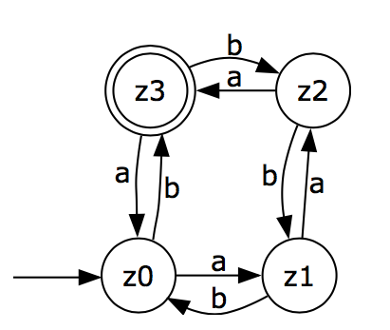
Automaton
Finite-state automaton: example
Q = {z₀, z₁, z₂, z₃}
Σ = {a, b}
q₀= z₀
X = {z₃}
δ:
δ(z₀, a) = z₁
δ(z₀, b) = z₃
δ(z₁, a) = z₂
δ(z₁, b) = z₀
δ(z₂, a) = z₃
δ(z₂, b) = z₁
δ(z₃, a) = z₀
δ(z₃, b) = z₂
Examples:
aaa finished
aaaab finished
bbaaabaaa finished
aa not finished
abba not finished
bbb not finished
(number of a’s in y) – (number of b’s in y) = 3 mod 4.

Slide 12
Automaton
Finite-state automaton: example
Input: abb

Slide 13
Automaton
Finite-state automaton: example
Input: abb

Slide 14
Automaton
Finite-state automaton: example
Input: abb

Slide 15
Automaton
Finite-state automaton: example
Input: abb
z3 is a terminal state:
Input is recognized
(abb is part of the language
recognized by the DFA)

Slide 16
Automaton
Finite-state automaton: example 2
Input: aab

Slide 17
Automaton
Finite-state automaton: example 2
Input: aab

Slide 18
Automaton
Finite-state automaton: example 2
Input: aab

Slide 19
Automaton
Finite-state automaton: example 2
Input: aab
z1 is not a terminal state:
Input is not recognized
(aab is not part of the language
recognized by the DFA)

Slide 20
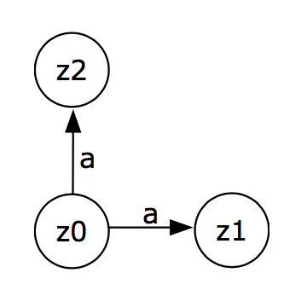
Nondeterministic finite-state automata
So far we have considered deterministic state changes:
every input character (or command) has maximally one state change
A nondeterministic automaton can “select” among transitions
accepts any word that has at least one path from the start state q₀ to an accept state X

Slide 21
Nondeterministic finite-state automaton
Definition: non-deterministic finite state automaton (NFA)
A non-deterministic finite state automaton is defined by a 5-tuple M = (Q, Σ, δ, q₀, X) consisting of :
Q, a finite set of states
Σ, a finite set of input symbols called the alphabet, Q ∩ Σ = ∅
δ: Q × Σ → P(Q), a transition function where P(Q) is a set of states
q₀ ∈ Q, an initial or start state
X ⊆ Q, a set of accept states
In NFA, Σ can contain ε
Theorem (Rabin, Scott)
any NFA can be simulated by a DFA (with many more states)
in other words, NFAs and DFAs are equivalent

Slide 22
Formal Languages and Grammars
Questions of Theoretical Computer Science
Finite-state Automata
Formal Languages and Grammars
The Chomsky Hierarchy
Push-down Automata

Slide 23
Grammar
Initial motivation: How do we ensure that command (or input) is a syntactically correct part of a given language?
Gave rise to the field of automata theory in theoretical computer science
informally: an automaton is a state space representation of a program, i.e., the description of program flow through incremental transitions between some (elementary) program states
Grammars help us to answer the question:
What can be computed with a finite-state automaton?
A grammar is a formal set of rules from which you can derive all inputs that make the automaton stop and no input for which the automaton does not stop

Slide 24
Nomenclature about formal languages
Kleene star operator *
operation on a given set V
amounts to the concatenation of V on itself, i.e., any finite combination of the elements of V
example: V = {+, 1, 2} then V* = {+, 1, 2, +1, +2, 2+, 12, 1+2,+12,++++, etc.}
V⁺ is V* without the empty word ε
Formal Language L
set of strings of symbols formed from its alphabet Σ
formally: L ⊆ Σ*
abstract definition: in practice, a well-formed (programming) language further requires definition of an appropriate grammar G that limits which words are syntactically permitted

Slide 25
Grammar
A finite set of formal rules for generating syntactically correct sentences.
Definition: Grammar
A Grammar is a 4-tuple G = (N, Σ, P, S) that satisfies the following conditions:
N is a finite set of all variables (or nonterminal symbols) — symbols which take part in the generation of the sentence but are not the component of the sentence (denoted by capital letters)
Σ is a finite set: the alphabet of terminal symbols such that N ∩ Σ = ∅. Symbols which are the components of the sentences generated using a grammar. (denoted by small letters)
P is the finite set of production rules, P ⊆ (N ∪ Σ)⁺ × (N ∪ Σ)* that map one string of symbols to another (denoted by “→“)
S ∈ N is the start variable

Slide 26
Grammar: example
Grammar that generates proper bracketed arithmetic expressions:
N = {Expr, Term, Fact}
Σ = {(, ), a, +, *}
S = Expr
P = {
Expr → Term (1)
Expr → Expr + Term (2)
Term → Fact (3)
Term → Term * Fact (4)
Fact → a (5)
Fact → (Expr) (6) }
This grammar produces correct arithmetic expressions with parentheses
for example: a * (a + a) + a

Slide 27
Grammar: derivation example
Grammar that generates proper bracketed arithmetic expressions:
N = {Expr, Term, Fact}
Σ = {(, ), a, +, *}
S = Expr
P = {
Expr → Term (1)
Expr → Expr + Term (2)
Term → Fact (3)
Term → Term * Fact (4)
Fact → a (5)
Fact → (Expr) (6) }
This grammar produces correct arithmetic expressions with parentheses
for example: a * (a + a) + a
Derivation of a * (a + a) + a
S
(1) Expr
(2) Expr + Term
(1) Term + Term
(4)(3) Term * Fact + Fact
(3)(6)(5) Fact * (Expr) + a
(5)(2) a * (Expr + Term) + a
(1) a * (Term + Fact) + a
(3) a * (Fact + a) + a
(5) a * (a+a) + a

Slide 28
Derivation tree example
Derivation tree:
Expr
Derivation of a * (a + a) + a
S
(1) Expr
(2) Expr + Term
(1) Term + Term
(4)(3) Term * Fact + Fact
(3)(6)(5) Fact * (Expr) + a
(5)(2) a * (Expr + Term) + a
(1) a * (Term + Fact) + a
(3) a * (Fact + a) + a
(5) a * (a+a) + a
Expr
+
Term
Term
Fact
Fact
Term
*
a
(
Expr
)
Fact
a
Expr
+
Term
Term
Fact
Fact
a
a

Slide 29
Grammar ≡ Automaton
A grammar G = (N, Σ, P, S) is equivalent to its corresponding automaton M = (Q, Σ, δ, q₀, X) with the following mapping:
the automating uses the same input alphabet Σ
Q = N ∪ {X}, where X∉N i.e., the states of the automaton correspond to the variables of the grammar plus an additional state X
q₀ = S, i.e., the initial state derives from the start variable
E = {X}, i.e., the accept state is X
δ(A,a) ∋ B , if A → aB ∈ P, i.e., there exists a transition from state A to state B if the input is a
δ(A,a) ∋ X, A → a ∈ P, i.e., there exists a transition from state A to the final state X if the input is a

Slide 30
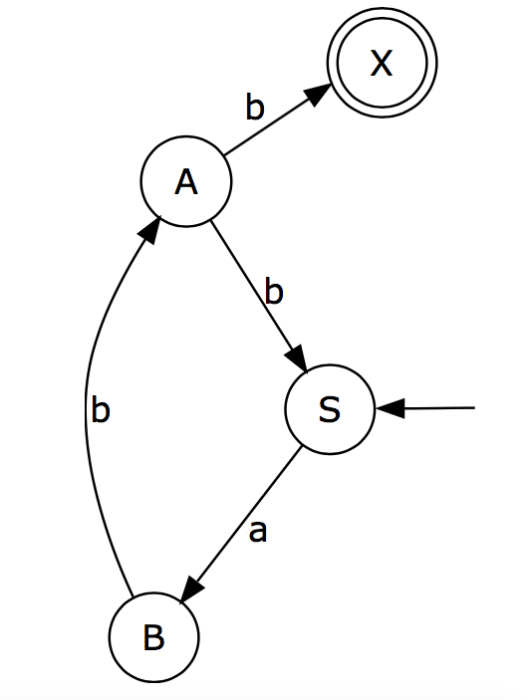
Grammar ≡ Automaton: example
Example transformation for Grammar G with:
Q = {S, A, B}
Σ = {a, b}
P = { S → aB, B → bA, A → b, A → bS }

Slide 31
Formal Languages
Definition: Formal Language
The language L defined by G is L(G) = { w ∈ Σ* | S ⇒_{G} w },
i.e., G derives w in zero or more steps from the start symbol S.
*
For example, the grammar with
Q = {S, A, B}
Σ = {a, b}
P = {S → aB, B → bA, A → b, A → bS}
Defines the language:
L(G) = {(abb)^{n} | n≥1}

Slide 32
Regular Languages
Theorem
Every language recognizable by finite automata is a regular language.
Regular Expressions (RE): R is a regular expression if R is:
a, such that a ∈ Σ (just a single character in the alphabet)
ε (the empty word)
∅ (the empty set)
R₁ | R₂ , where R₁ and R₂ are regular expressions, (alternative RE)
R₁R₂ , where R₁ and R₂ are regular expressions, or (concatenation of RE)
R₁*, where R₁ is a regular expression. (repetition of RE)

Slide 33
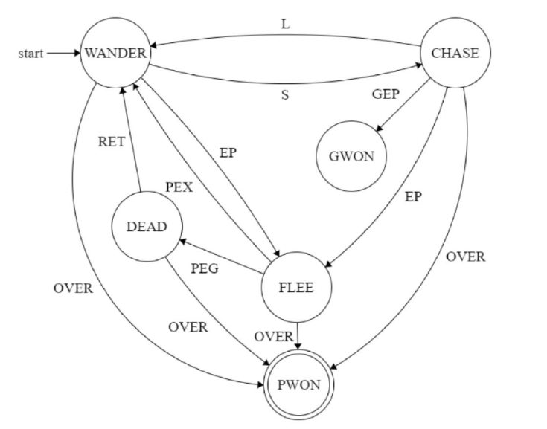
Pac-Man ghosts DFA
Emulating Pac-Man using Finite State Machines. Soumyabrata Bairagi, Bachelor Thesis, Indian Institute of Information Technology, Ranchi.
https://www.studocu.com/in/document/indian-institute-of-information-technology-dharwad/automata/pacman/23245898

Slide 34
Outtake – Social Science Applications
Extensive use of regular expressions in the domain of natural language processing
check words for validity, acceptor
separate a written text (a language) into elementary expressions
used to extract data matching keywords
allows also for much more complex pattern matching
Transducer, output depends on input, control applications, linguistics
Sequencer / generator of text

Slide 35
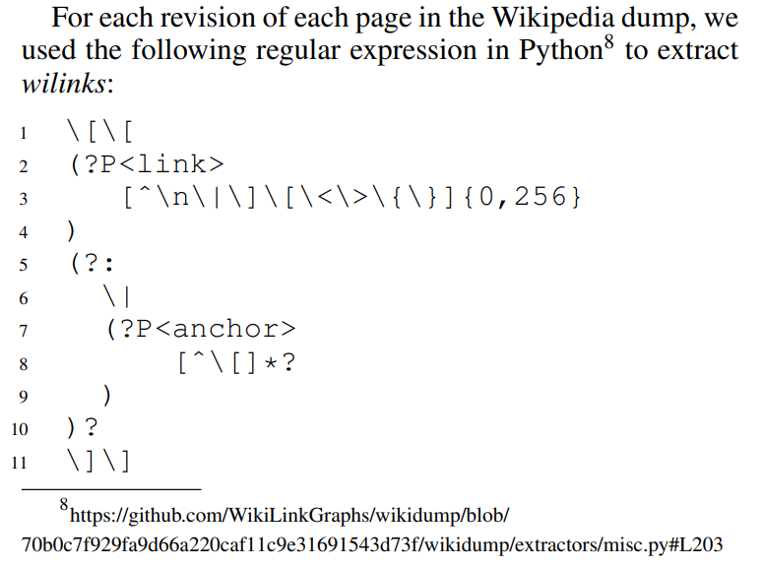
Outtake – Social Science Applications
WikiLinkGraphs: A Complete, Longitudinal and Multi-Language Dataset of the Wikipedia Link Networks. Cristian Consonni, David Laniado, Alberto Montresor. Proceedings of the Intenational Conference on the Web and Social Media (2019)

Slide 36
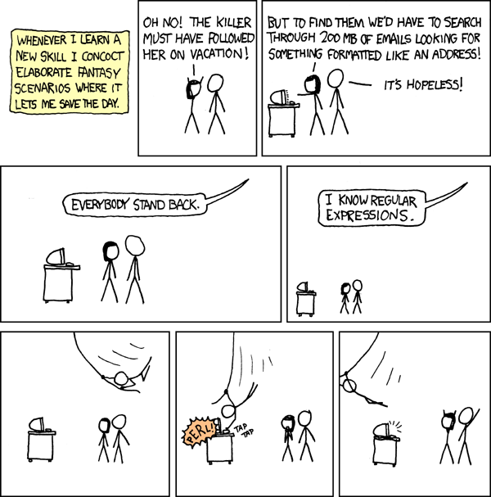
Outtake – Social Science Applications
XKCD: Regular Expressions https://xkcd.com/208/

Slide 37
Outtake – Social Science Applications
XKCD: Regular Expressions https://xkcd.com/208/

Slide 38
Outtake – Social Science Applications
XKCD: Regular Expressions https://xkcd.com/208/

Slide 39
The Chomsky Hierarchy
Questions of Theoretical Computer Science
Finite-state Automata
Formal Languages and Grammars
The Chomsky Hierarchy
Push-down Automata

Slide 40
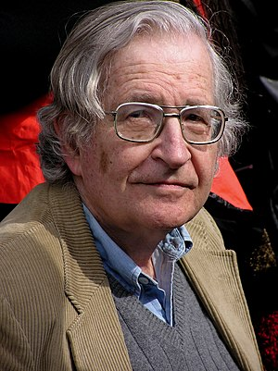
Noam Chomsky: Between math and linguistics
Avram Noam Chomsky (US, 1928)
Mathematical linguist, his work on formal languages started modern linguistics
Former MIT professor, now in University of Arizona
Thinking about languages based on the machines that can recognize them
Proposed important theories regarding natural language about metalanguage
Famous contributions to philosophy and media science (e.g. the propaganda model with Edward Herman)
Very popular due to his political commentary and outreach, e.g. interviews and public debates

Slide 41
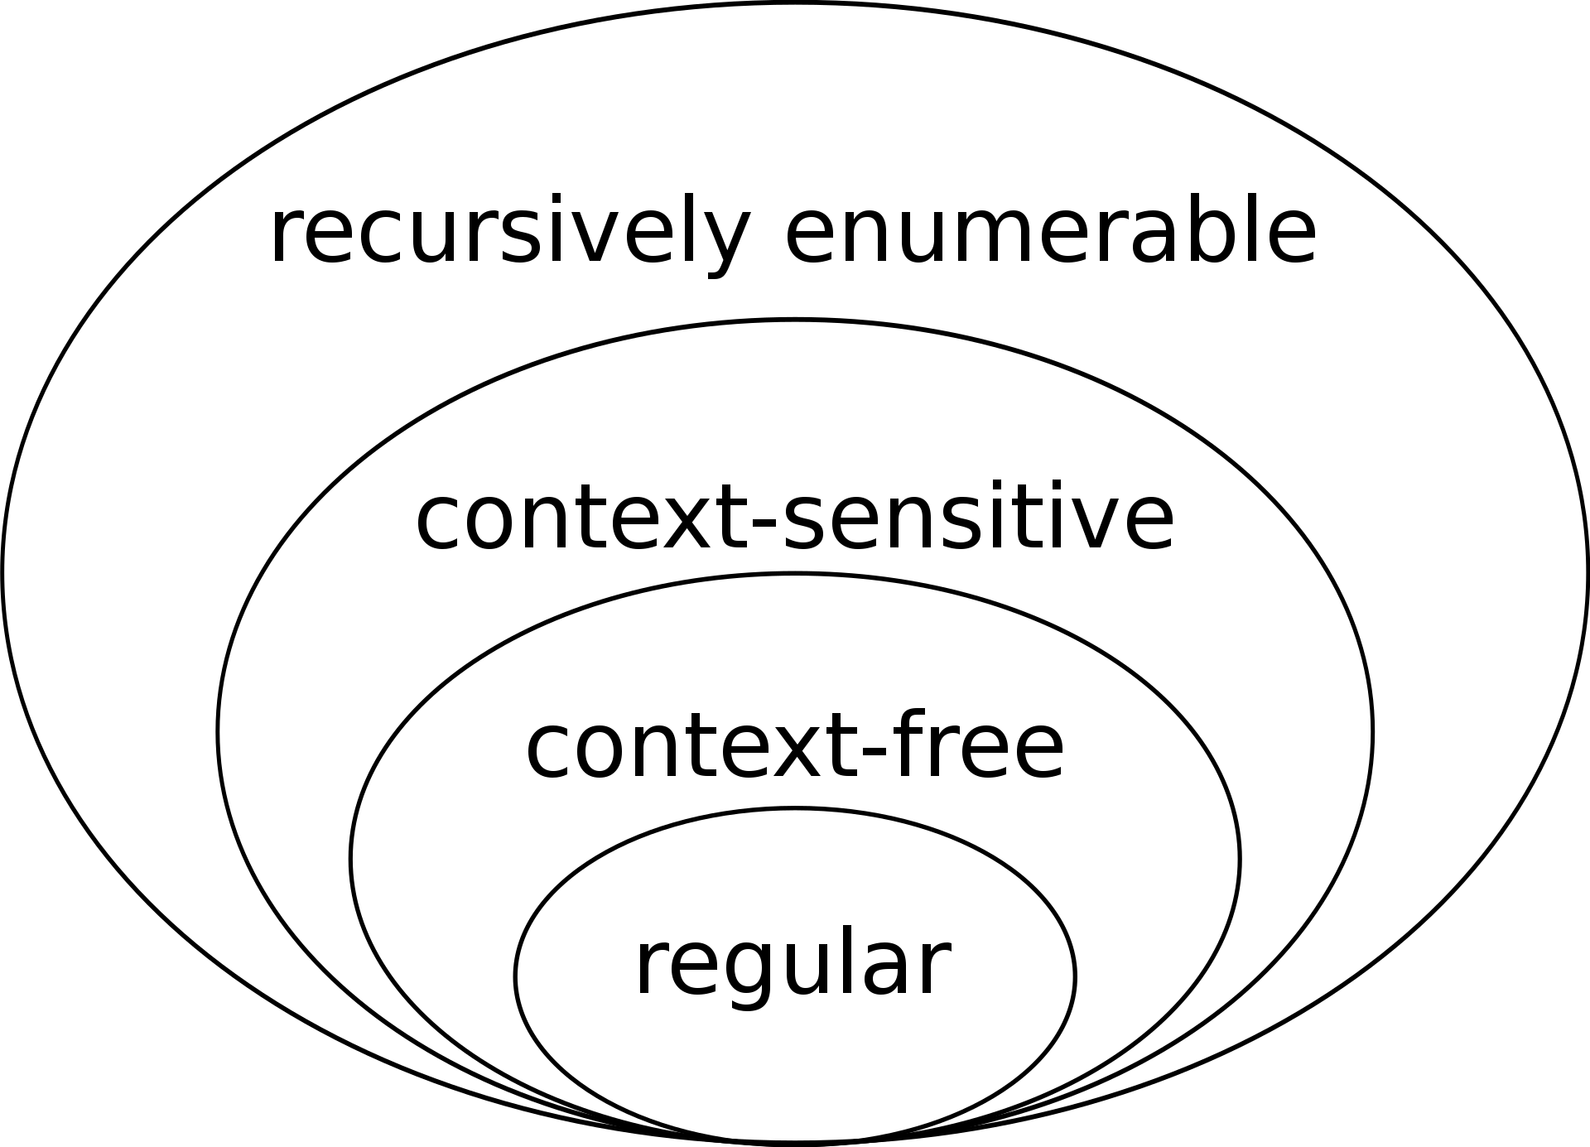
The Chomsky Hierarchy
Type | Type | Automaton | Applications | Rules | Rule | Recognizes
0 | Recursively enumerated | Turing machine infinite memory | All possible programs | α,β arbitrary Left at least one Non-term | α->β | all
1 | Context sensitive Language | Linear bounded Turing machine | Real programming language | Left at least one Non-term Left shorter | αAβ->αγβ | a^{n}b^{n}c^{n}
2 | Context free language | Pushdown automaton, stack | Programming language e.g. brackets | Left only one Non-term | A->α α is string of Term and Non-term | a^{n}b^{n}
3 | Regular expression | Finite state automaton | lexical structure, hardware implementations | Left only one Non-term | A-> aB Or A->Ba | a^{n}
Each type from outside (type 0) to
inside (type 3) is more and more restrictive.

Slide 42
Regular expressions
Definition of type 3 grammar: regular languages
A grammar is Type 3 or regular, if for all (production) rules w₁→ w₂ in P it is true that w₁ is a single variable, i.e., w₁ ∈ N, and w₂ ∈ Σ ∪ ΣN .
i.e., the right hand side are either:
the empty string
one terminal symbol (from the alphabet)
or one terminal symbol followed by one variable.
the definition of a regular language restricts all permissible words (commands) to a simple sequence of symbols (instructions)
to process words of this grammar we do not need any explicit memory, all the process needs to know for execution is defined by the current state it is in
this is basically the very definition of the simplest computing machine

Slide 43
Regular grammars: examples
The right hand side are either:
the empty string
one terminal symbol (from the alphabet)
or one terminal symbol followed by one variable.
S
aA
S
aA
S
wS
S
wS
A
aA
A
aAB
S
aA
S
aA
A
bB
A
bB
A
aA
AaB
aA
B
bB
B
bB
A
a
B
a
B
ε
B
ε
Regular
Not Regular

Slide 44
Type 3 grammars and DFA
Definition of type 3 grammar: regular languages
A grammar is Type 3 or regular, if for all (production) rules w₁→ w₂ in P it is true that w₁ is a single variable, i.e., w₁ ∈ N, and w₂ ∈ Σ ∪ ΣN .
Type-3 grammars generate regular languages. These languages are exactly all
languages that can be accepted by a Finite-State Automaton.
Finite state automata are the simplest machines to recognize patterns

Slide 45
Context-free grammars
Definition of Type 2 grammar: context-free grammar
A grammar is Type 2 or context-free, if for all (production) rules w₁→ w₂ in P it is true that w₁ is a single variable, i.e., w₁ ∈ N .
the definition of a context-free language restricts all permissible words (commands) to variable assignments where the right-hand side can be arbitrarily complex
to process (execute) words of this grammar we need an explicit memory where, in order to process inputs, we can “stack” the complex commands
this is the simplest generalization of the previous language allowing for more complex, layered state structures
S → AB
A → a
B → b

Slide 46
Context-sensitive grammars
Definition of type 1 grammar: context-sensitive grammar
A grammar is Type 1 or context-sensitive, if for all (production) rules w₁→ w₂ in P, it holds that | w₁ | ≤ | w₂ |
left-hand side of a rule has to be at most as complex as the right-hand side
this is the logical next step in generalizing a grammar such that the production rules are explicitly context-dependent, i.e., it matters in which exact sequence non-terminal and terminal symbols occur for a certain rule to apply
closest model to complexity on an actual programming language that we can execute with finite RAM
S → AB
AB → abc
B → b

Slide 47
Unrestricted grammars
Definition of type 0 grammars: unrestricted grammars
Every grammar is automatically of Type 0. The rule of the Grammar are unrestricted. These languages are also known as recursively enumerable or Turing-recognizable.
this lifts the last restriction we imposed on how complex the left-hand side of a production rule can be
this implies that we need a memory that can keep track of, in principle, infinitely many steps needed to describe the left-hand side in order to execute the right hand side
should be structurally very similar to the Type 1 computing machine just has to be able to access infinite memory
Sab → ba
A → S

Slide 48
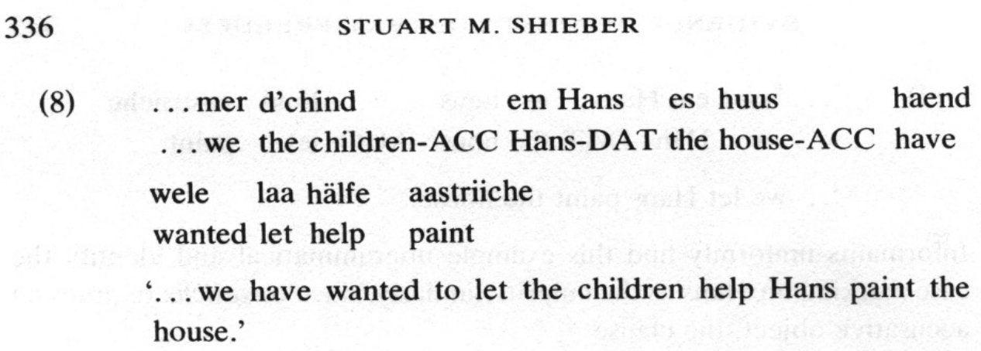
The Chomsky Hierarchy and natural languages
The vast majority of natural languages have context-free grammars, but some exceptions exist, e.g. Swiss German.
Evidence against the context-freeness of natural language, Stuart M. Shieber, 1985

Slide 49
Push-down Automata
Questions of Theoretical Computer Science
Finite-state Automata
Formal Languages and Grammars
The Chomsky Hierarchy
Push-down Automata

Slide 50
Context-free Languages
Definition of Type 2 grammar: context-free grammar
A grammar is Type 2 or context-free, if for all (production) rules w₁→ w₂ in P it is true that w₁ is a single variable, i.e., w₁ ∈ N .
Examples:
Grammar that ensures proper bracketing for arithmetic expressions
Instructions in a programming language
Other formal languages, especially those that cannot be recognized by a DFA
Expr → Term | Expr + Term Term → Fact | Term * Fact Fact → a | (Expr)
<Inst> <While-Inst> | <If-Inst> <While-Inst> while (<condition>) {<Inst>} <If-Inst> if (<condition>) {<Inst>} <condition> …
L = {a^{n}b^{n} | n ≥ 1}: S → ab | aSb

Slide 51
Push-Down Automata (PDA)
Finding a automaton representation for context-free languages:
finite-state automaton that uses a stack as memory. This makes PDA more powerful than DFA
Definition: push-down automaton
A (nondeterministic) push-down automaton (PDA) is defined by a 6-tuple M = (Q, Σ, Γ, δ, q₀, #) consisting of:
Q, a finite set of states
Σ, a finite set of symbols called the input alphabet,
Γ, a finite set of symbols called the stack alphabet (different from DFA)
δ: Q × {Σ∪ {ε}} × Γ → P(Q × Γ*), a transition function
q₀ ∈ Q, an initial or start state
# ∈ Γ, the initial stack symbol (different from DFA)

Slide 52
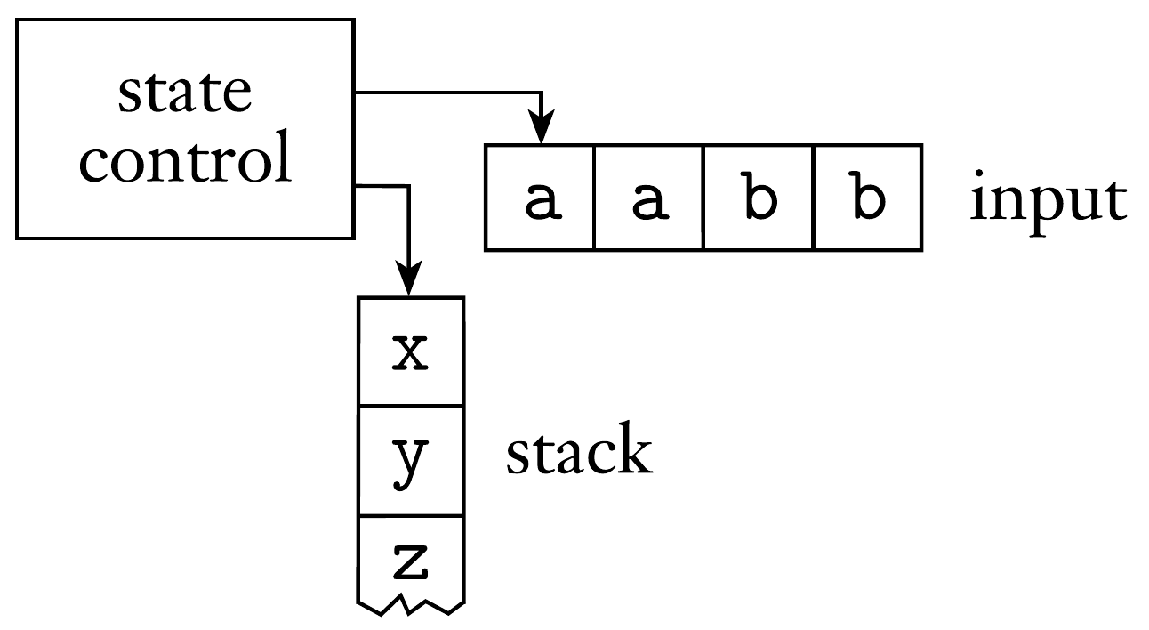
Push-down Automata
Intuition of push-down automaton:
as before for DFA, execution from left to right
if possible, process symbol right away
if not possible, delay processing and continue with layered call until processing becomes possible (recursive logic)
push-down automaton accepts a word if, after execution, the stack is empty

Slide 53
Push-down Automata
Interpretation of transition function δ(z ,a ,A) ∋ (z′, γ)
Input to transition function is a 3-tuple (z, a, A)
automaton is in state z
push-down automaton reads a (input symbol)
A is a stack symbol that should be on top of the stack
Output to transition function is a pair (z’, γ)
z’ is the new state in Q that the PDA transitions to
γ=B₁…B_{k} is the string of stack symbols to replace A on the top of the stack
if upper element in stack is A, transition to z’ and replace A with B₁…B_{k}
if k = 0 (empty string), just remove the upper element A
push-down automaton accepts a word if after execution the stack is empty
do not need to define an explicit end state

Slide 54
Push-down Automaton Example
L = {w | w ∈ {a, b, x, y, z}* ∧ |w|_{a} = |w|_{b} }
Note: there is only one state
input
x
a
y
a
z
z
b
z
b
ε
Input | Stack | Action
a | # | Push A
a | A | Push A
b | # | Push B
b | B | Push B
b | A | Pop
a | B | Pop
x-z
ε | # | Pop
stack
Process x
#

Slide 55
Push-down Automaton Example
L = {w | w ∈ {a, b, x, y, z}* ∧ |w|_{a} = |w|_{b} }
input
x
a
y
a
z
z
b
z
b
ε
Input | Stack | Action
a | # | Push A
a | A | Push A
b | # | Push B
b | B | Push B
b | A | Pop
a | B | Pop
x-z
ε | # | Pop
stack
Push A
A
#

Slide 56
Push-down Automaton Example
L = {w | w ∈ {a, b, x, y, z}* ∧ |w|_{a} = |w|_{b} }
input
x
a
y
a
z
z
b
z
b
ε
Input | Stack | Action
a | # | Push A
a | A | Push A
b | # | Push B
b | B | Push B
b | A | Pop
a | B | Pop
x-z
ε | # | Pop
stack
Process y
A
#

Slide 57
Push-down Automaton Example
L = {w | w ∈ {a, b, x, y, z}* ∧ |w|_{a} = |w|_{b} }
input
x
a
y
a
z
z
b
z
b
ε
Input | Stack | Action
a | # | Push A
a | A | Push A
b | # | Push B
b | B | Push B
b | A | Pop
a | B | Pop
x-z
ε | # | Pop
stack
Push A
A
A
#

Slide 58
Push-down Automaton Example
L = {w | w ∈ {a, b, x, y, z}* ∧ |w|_{a} = |w|_{b} }
input
x
a
y
a
z
z
b
z
b
ε
Input | Stack | Action
a | # | Push A
a | A | Push A
b | # | Push B
b | B | Push B
b | A | Pop
a | B | Pop
x-z
ε | # | Pop
stack
Process z
A
A
#

Slide 59
Push-down Automaton Example
L = {w | w ∈ {a, b, x, y, z}* ∧ |w|_{a} = |w|_{b} }
input
x
a
y
a
z
z
b
z
b
ε
Input | Stack | Action
a | # | Push A
a | A | Push A
b | # | Push B
b | B | Push B
b | A | Pop
a | B | Pop
x-z
ε | # | Pop
stack
Process z
A
A
#

Slide 60
Push-down Automaton Example
L = {w | w ∈ {a, b, x, y, z}* ∧ |w|_{a} = |w|_{b} }
input
x
a
y
a
z
z
b
z
b
ε
Input | Stack | Action
a | # | Push A
a | A | Push A
b | # | Push B
b | B | Push B
b | A | Pop
a | B | Pop
x-z
ε | # | Pop
stack
Pop
A
#

Slide 61
Push-down Automaton Example
L = {w | w ∈ {a, b, x, y, z}* ∧ |w|_{a} = |w|_{b} }
input
x
a
y
a
z
z
b
z
b
ε
Input | Stack | Action
a | # | Push A
a | A | Push A
b | # | Push B
b | B | Push B
b | A | Pop
a | B | Pop
x-z
ε | # | Pop
stack
Process z
A
#

Slide 62
Push-down Automaton Example
L = {w | w ∈ {a, b, x, y, z}* ∧ |w|_{a} = |w|_{b} }
input
x
a
y
a
z
z
b
z
b
ε
Input | Stack | Action
a | # | Push A
a | A | Push A
b | # | Push B
b | B | Push B
b | A | Pop
a | B | Pop
x-z
ε | # | Pop
stack
Pop
#

Slide 63
Push-down Automaton Example
L = {w | w ∈ {a, b, x, y, z}* ∧ |w|_{a} = |w|_{b} }
input
x
a
y
a
z
z
b
z
b
ε
Input | Stack | Action
a | # | Push A
a | A | Push A
b | # | Push B
b | B | Push B
b | A | Pop
a | B | Pop
x-z
ε | # | Pop
stack
Stack is empty:
input accepted
#

Slide 64
Notes on PDA example
The example has only one state
The PDA encodes its state in the stack
PDA do not often require many states
Example of deterministic PDA
z₀

Slide 65

Further Readings
Chapters 1 & 2 of Introduction to the Theory of Computation,
by Michael Sipser
Chapters contain additional proofs and lemmas,
but also everything else seen here (except Chomsky hierarchy)

Slide 66
After the holiday break
Turing Machines
Computability
Complexity Classes

